Slide 1
Integrating API into React App 2

Slide 2
Integration Considerations
Review API Design
Develop front end API Module
Endpoints
Routes
React Authentication Context
React Login/Registration Page

Slide 3
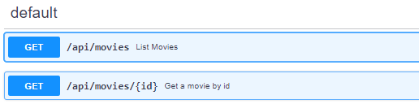
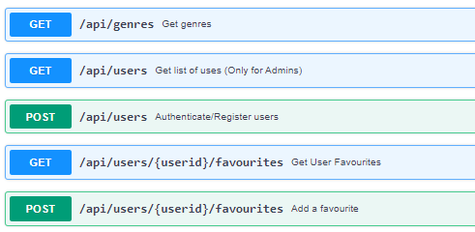
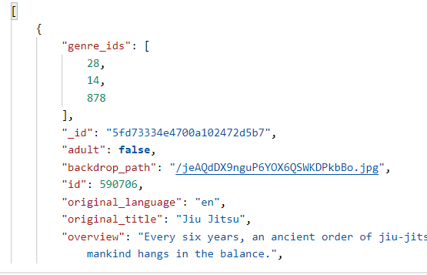
Review API Design
Fully understand the API
Examine Routes
Examine Request & Response Requirements
Body (e.g. properties)
Format (e.g. json)
Examine Authentication
JWT/Sessions
TEST WITH POSTMAN
Even better, write unit tests!

Slide 4
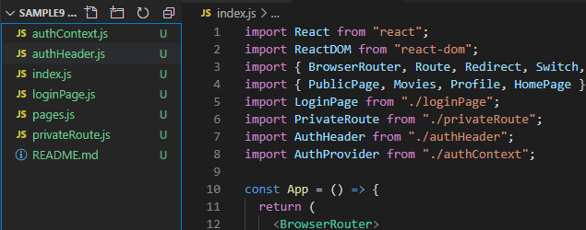
Design React App
Ideally this would be your Movies App from assignment 1
You have used TMDB up to now
You can update to include authentication(login/register) pages and routes

Slide 5
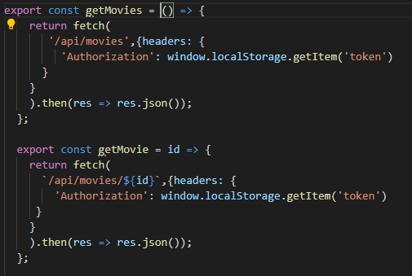
Write/Update API Module
Abstract API calls to exported functions.

Slide 6
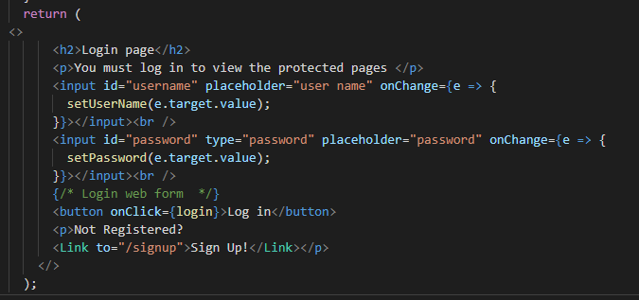
Update pages to use Contexts
Login Page:

Slide 7

Assignment 2
Web API

Slide 8
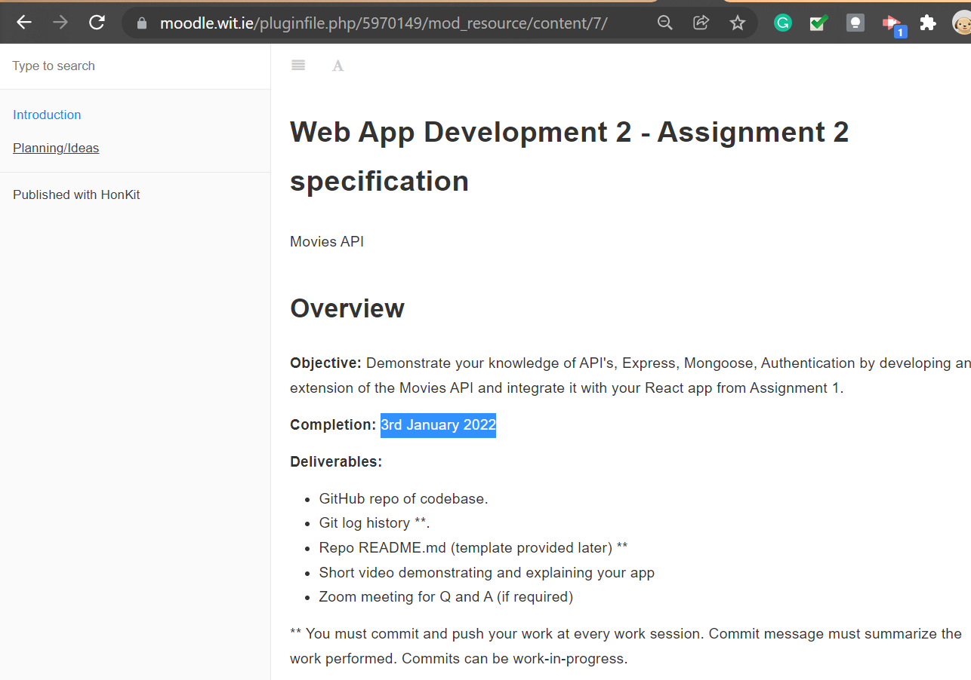
Assignment 2
It’s here: https://moodle.wit.ie/mod/resource/view.php?id=3870295
40% of your overall mark
Submit on Moodle (Repo)
Due 3rd January.

Slide 9
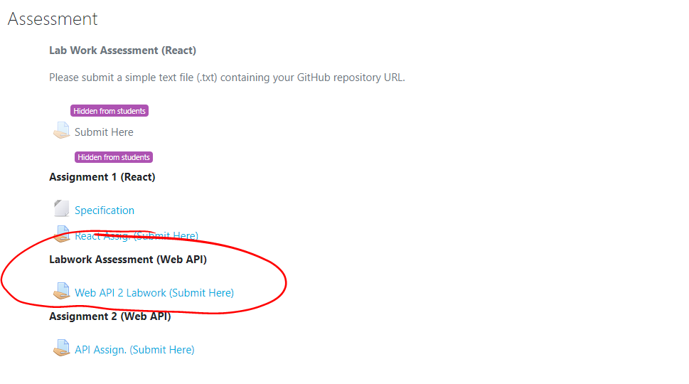
Labwork Assessment
10% of your overall mark
Finish changes to repo by 12th December (or earlier if you’re complete)
We will be looking at commit history.
You’ve already submitted Moodle(repo)

Slide 10
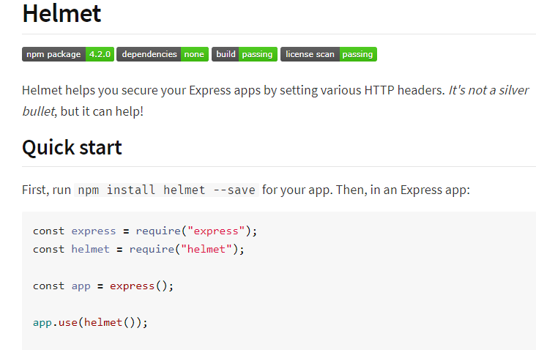
Extra Stuff Examples
Helmet
Better Error Handling
Logging
https://blog.bitsrc.io/23-insanely-useful-nodejs-libraries-you-should-know-in-2020-5a9b570d5416

